Slide 1
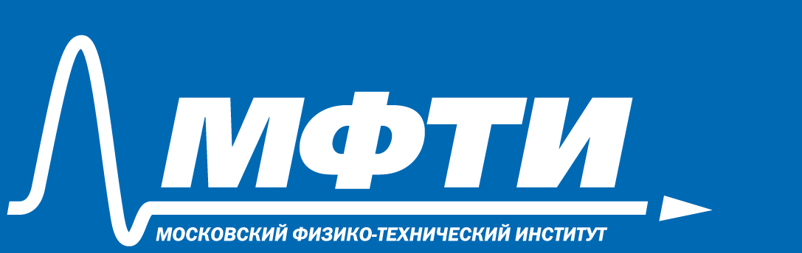
Cloud Security Principles and Concepts
Amit Kumar Jaiswal
PhD student Researcher. Lecturer-researcher , 2 course Group A01-305b
Department of Intelligent Information Systems and Technologies

Slide 2
What is cloud security principles?
The cloud security principles are intended to assist you select a cloud provider that satisfies your security requirements.
You will need to think about how to configure your cloud services safely.
These ideas apply to both cloud platforms and software as a service.
We characterize each premise as follows:
The security objectives that a successful cloud service should achieve
Differentiators to look for that either increase your trust in the cloud service or make it easier for you to satisfy your own security duties.
Some recommendations on how the cloud provider may have satisfied the goals.
Any associated factors you must make while deciding if the service satisfies your needs.
For each security principle stated below, you should examine the cloud service and the firm that operates it to evaluate how well each of the goals outlined in that principle is accomplished. Different techniques will produce various hazards for you to consider.
Using one of the implementation options described above, the service may be able to achieve its aim. However, these are merely recommendations; other options that we haven't included may be equally successful.
You should also analyze the evidence offered to give you enough trust in the cloud provider's assertions. We have suggested some ways of finding how a cloud provider meets the goals of these principles, and how they might have evidenced them on the choosing a cloud provider page

Slide 3
The principles
Principle 1: Data in transit protection
Principle 2: Asset protection and resilience
Principle 3: Separation between customers
Principle 4: Governance framework
Principle 5: Operational security
Principle 6: Personnel security
Principle 7: Secure development
Principle 8: Supply chain security
Principle 9. Secure user management
Principle 10: Identity and authentication
Principle 11: External interface protection
Principle 12: Secure service administration
Principle 13: Audit information and alerting for customers
Principle 14: Secure use of the service

Slide 4
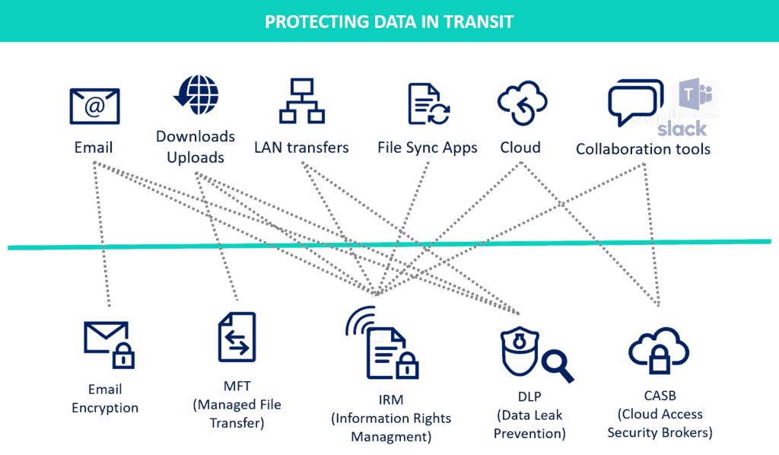
Principle 1: Data in transit protection
Your data should be appropriately safeguarded from alteration and eavesdropping while it travels over networks both internal and external to the cloud.
This should be accomplished by a mix of encryption, service authentication, and network-level security.
Read Principle 1:
https://www.ncsc.gov.uk/collection/cloud/the-cloud-security-principles/principle-1-data-in-transit-protection

Slide 5
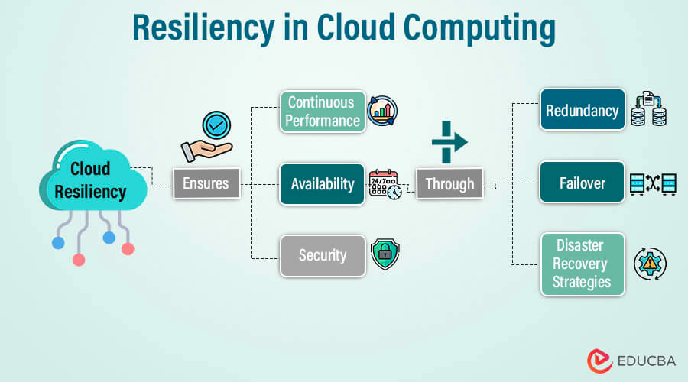
Principle 2: Asset protection and resilience
Your data, as well as the assets used to store or process it, should be safeguarded from physical manipulation, loss, destruction, or confiscation.
Protections should include coverage for the legislation that applies to your data, as well as mitigations such encryption, data center security, safe erasure, and service resilience.
Read Principle 2:
https://www.ncsc.gov.uk/collection/cloud/the-cloud-security-principles/principle-2-asset-protection-and-resilience

Slide 6
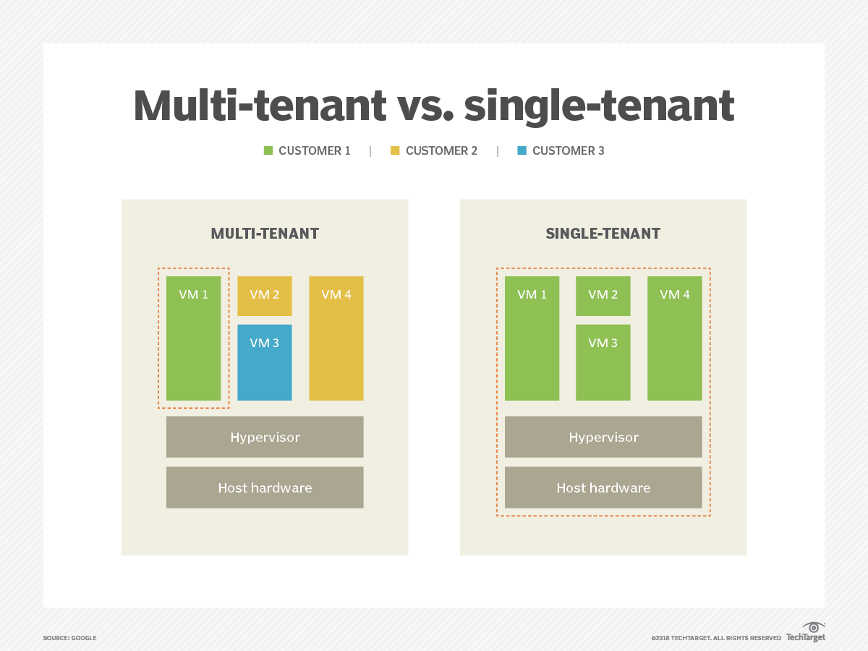
Principle 3: Separation between customers
A malevolent or hacked client of the service should be unable to access or impact another's service or data.
It will need to establish effective security limits in how it runs code, stores data, and administers the network
Read Principle 3:
https://www.ncsc.gov.uk/collection/cloud/the-cloud-security-principles/principle-3-separation-between-customers

Slide 7
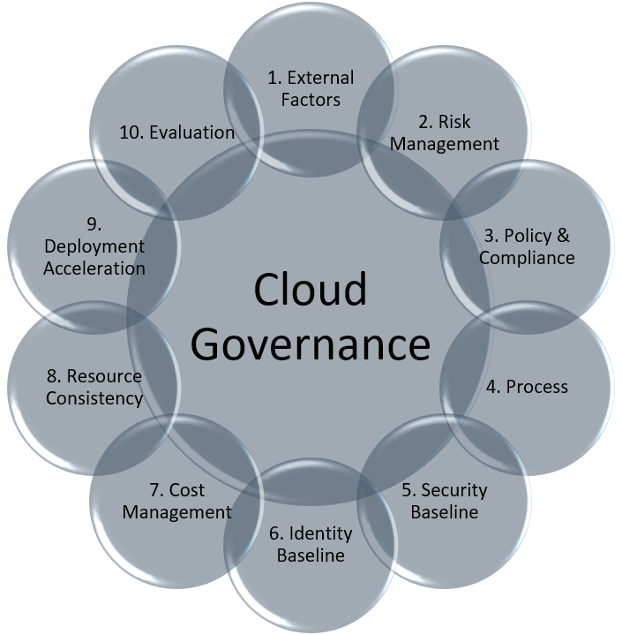
Principle 4: Governance framework
The service provider should have a security governance structure that coordinates and leads the administration of the service and its associated information.
This gives you assurance that such controls will be effective for the duration of the service.
Read Principle 4:
https://www.ncsc.gov.uk/collection/cloud/the-cloud-security-principles/principle-4-governance-framework

Slide 8
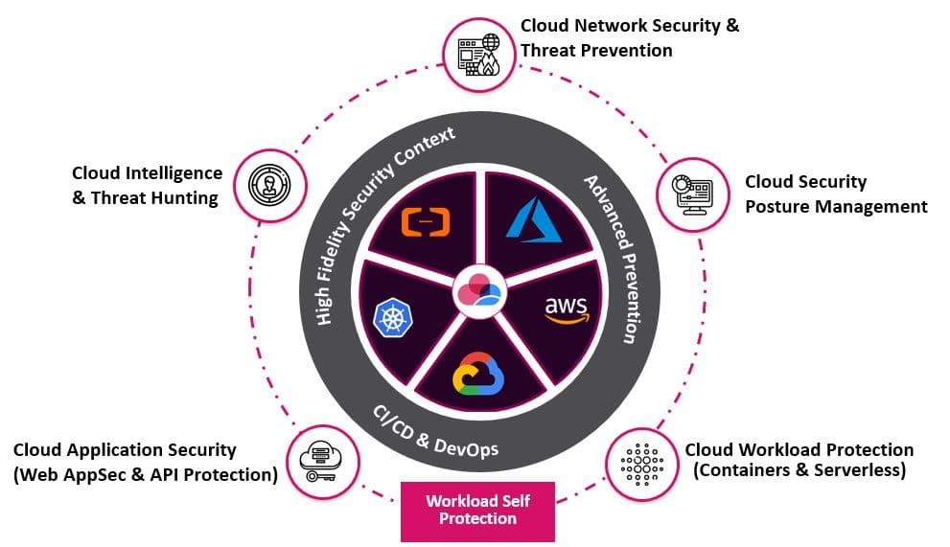
Principle 5: Operational security
The service must be securely run and managed in order to hinder, detect, or prevent assaults.
It will do this through a mix of effective vulnerability management, protective monitoring, configuration and change management, and incident response.
Read Principle 5:
https://www.ncsc.gov.uk/collection/cloud/the-cloud-security-principles/principle-5-operational-security

Slide 9
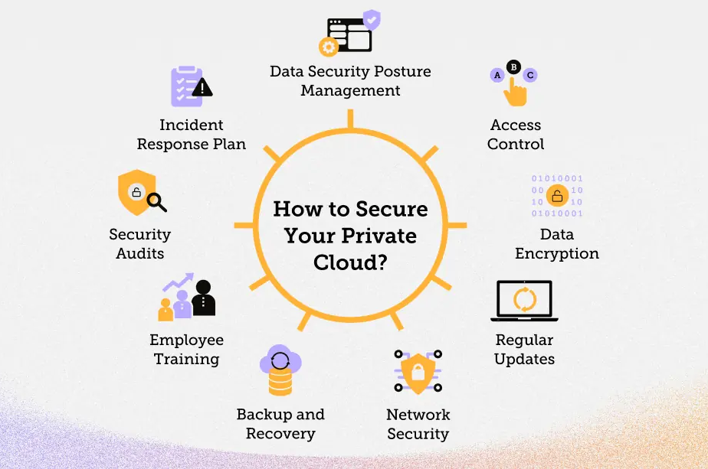
Principle 6: Personnel security
Where service provider people have access to your data and systems, you must have high confidence in their trustworthiness and the technical safeguards in place to audit and control those staff's actions.
Read Principle 6:
https://www.ncsc.gov.uk/collection/cloud/the-cloud-security-principles/principle-6-personnel-security

Slide 10
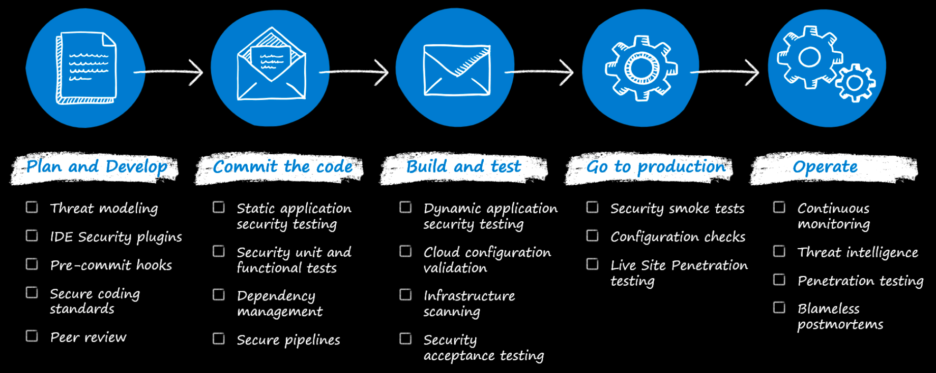
Principle 7: Secure development
Cloud services should be planned, developed, and deployed in a way that reduces and mitigates security risks.
This will feature a complete software development lifecycle with an automated and auditable integration and deployment pipeline.
Read Principle 7:
https://www.ncsc.gov.uk/collection/cloud/the-cloud-security-principles/principle-7-secure-development

Slide 11
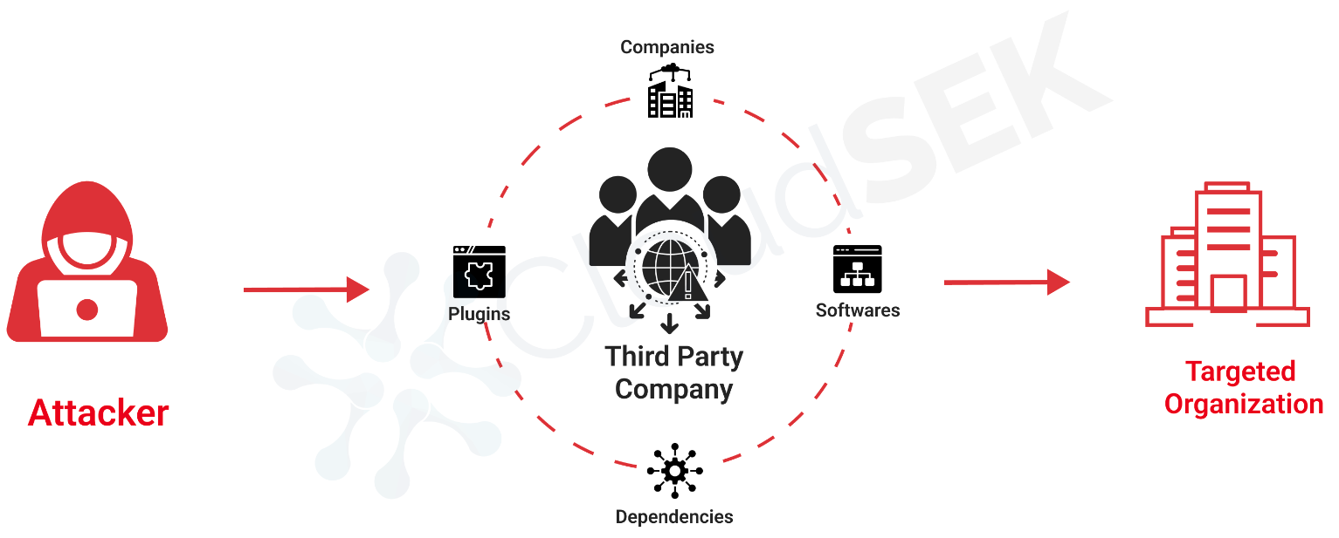
Principle 8: Supply chain security
The service provider should guarantee that its supply chain adheres to the same security requirements as the company.
This covers situations in which a third party has access to client data or the service, as well as when the provider is reliant on a third party, such as when purchasing hardware and software.
Read Principle 8:
https://www.ncsc.gov.uk/collection/cloud/the-cloud-security-principles/principle-8-supply-chain-security

Slide 12
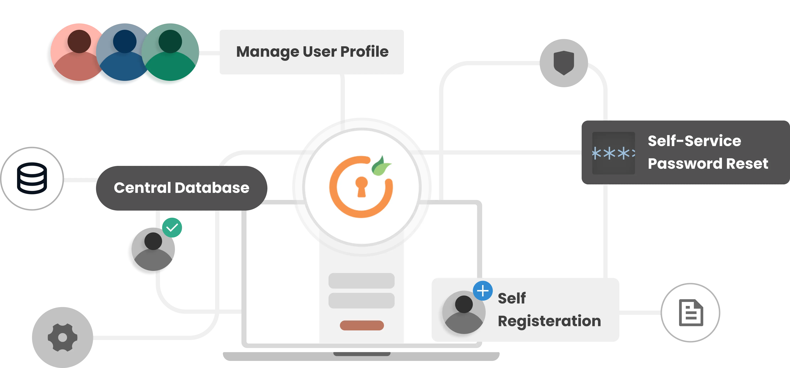
Principle 9. Secure user management
Your provider should give you with the tools you need to securely manage your usage of their service, prohibiting unauthorized access and changes to your resources, apps, and data.
This will normally include an access model that lets you to set role-based access restrictions throughout the service and the data it contains.
Read Principle 9: https://www.ncsc.gov.uk/collection/cloud/the-cloud-security-principles/principle-9-secure-user-management

Slide 13
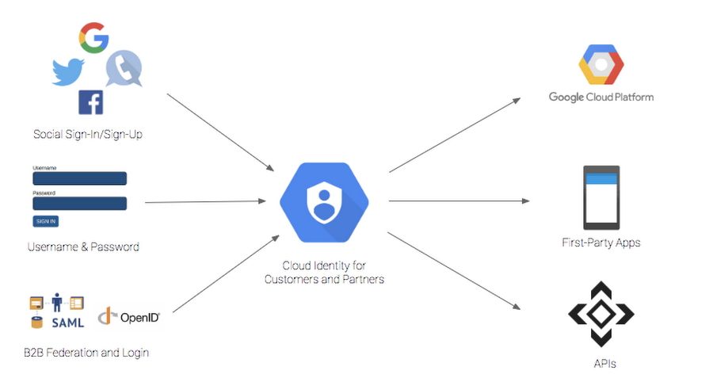
Principle 10: Identity and authentication
All access to service interfaces should be limited to a securely authenticated and approved identity, which might be either a human or a computer
Read Principle 10:
https://www.ncsc.gov.uk/collection/cloud/the-cloud-security-principles/principle-10-identity-and-authentication

Slide 14
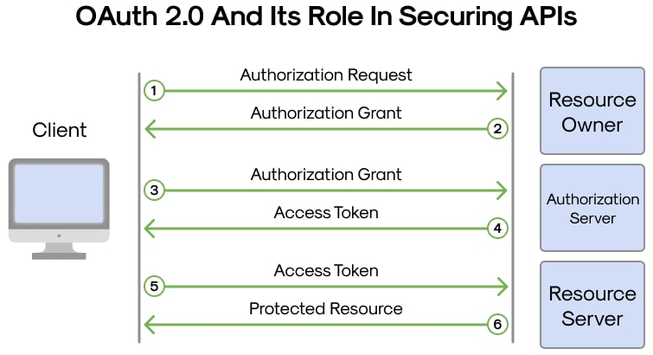
Principle 11: External interface protection
All of the service's external or less trustworthy interfaces should be recognized and properly guarded.
This encompasses external APIs, web consoles, and command line interfaces.
Read Principle 11:
https://www.ncsc.gov.uk/collection/cloud/the-cloud-security-principles/principle-11-external-interface-protection

Slide 15
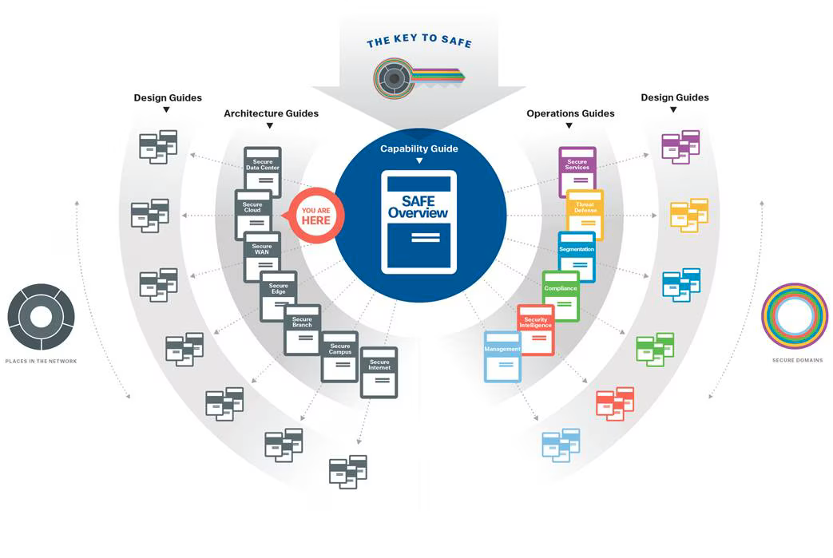
Principle 12: Secure service administration
The design, deployment, and maintenance of the cloud service provider's administration systems should adhere to business best practices, understanding their significant value to attackers.
Read Principle 12:
https://www.ncsc.gov.uk/collection/cloud/the-cloud-security-principles/principle-12-secure-service-administration

Slide 16
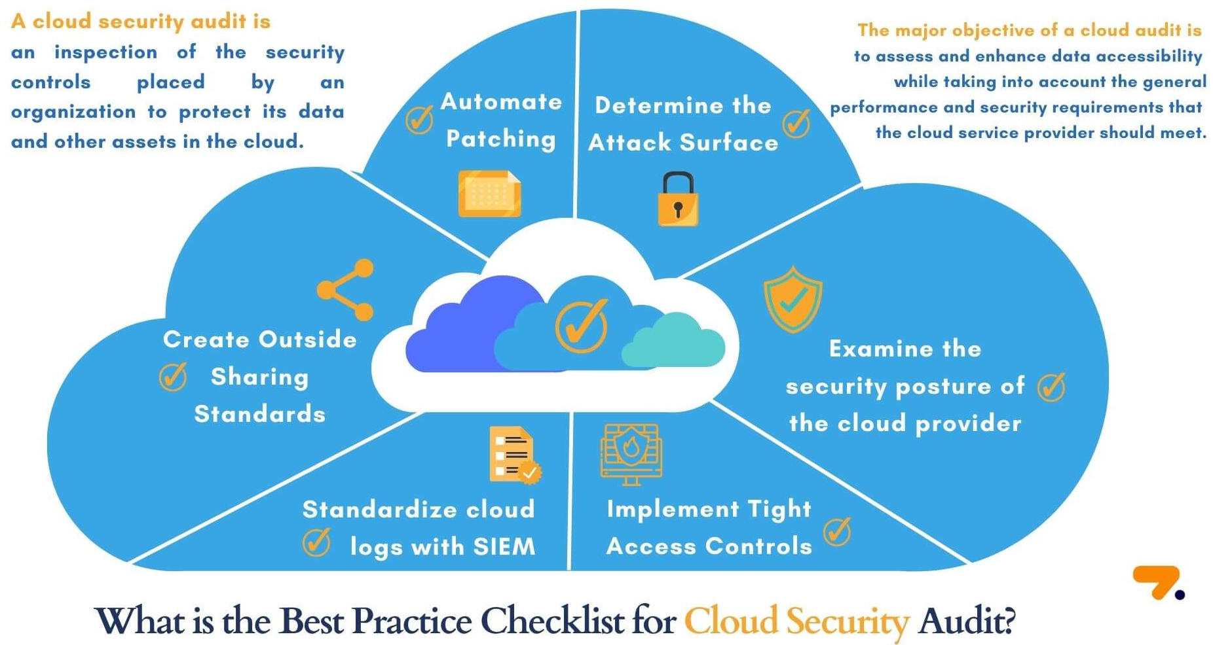
Principle 13: Audit information and alerting for customers
You should be able to detect security issues and have the information needed to determine how and when they happened.
When attempted assaults are identified, the service must provide you with audit information and send out security notifications.
Read Principle 13:
https://www.ncsc.gov.uk/collection/cloud/the-cloud-security-principles/principle-13-audit-information-and-alerting-for-customers

Slide 17
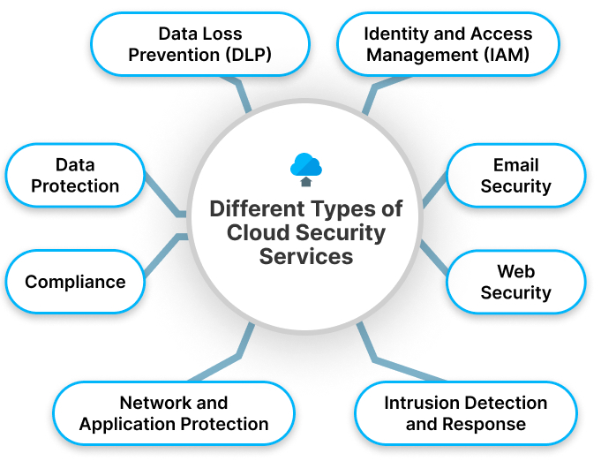
Principle 14: Secure use of the service
Your cloud provider should make it easy for you to fulfill your data protection obligations. Services must be secure by design and default.
Where this is not the case, the provider should assist you in carrying out your security duties
Read Principle 14:
https://www.ncsc.gov.uk/collection/cloud/the-cloud-security-principles/principle-14-secure-use-of-the-service

Slide 18
Conclusion
The environment of cloud security is complicated and ever-changing.
Organizations must take a proactive approach and include core security concepts into their cloud plans.
By doing so, companies may successfully protect their digital assets from a variety of risks while remaining compliant with applicable requirements.
Continuous improvement and adapting to new difficulties will be critical for long-term success in cloud security management.

Slide 19
References
3. Принципы и концепции / Principles and Concepts
Chris Dotson. Practical Cloud Security. A Guide for Secure Design and Deployment. // 2024. pp. 230

